Slide 1
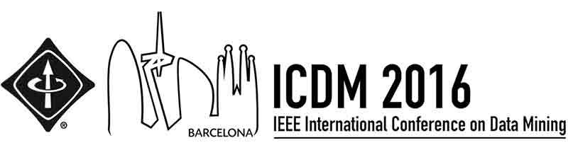



Edge Weight Prediction in Weighted Signed Networks
Srijan Kumar, Univ. of Maryland
Francesca Spezzano, Boise State Univ.
V.S. Subrahmanian, Univ. of Maryland
Christos Faloutsos, Carnegie Mellon Univ.

Slide 2





Ratings are everywhere
Notes:
Ratings are everywhere. On platforms like Amazon and Yelp, people rate products from 1-5 stars. On other platforms like Epinions, Slashdot and Bitcoin trust networks, people rate other people to express opinion towards each other.

Slide 3


Weighted Signed Edges
-0.2
+0.1
-0.9
+1
Positive edges: Trust, Like, Support, Agree
Negative edges: Distrust, Dislike, Oppose, Disagree
Weights: Strength of the relation
Edge weights lie between -1 and +1
Notes:
On any such platform, relations can be expressed very naturally using weighted and signed edges.
For instance, a person may like or trust another a lot or a little, or dislike someone a lot and someone else a little.
All these relations - trust, like, support, agreement - can be represented with positive edges and distrust, dislike, opposition and disagreement can be represented with negative edges.
The strength of these relations can be represented by their weight.
Without loss of generality, we say that the edge weights lie between -1 and +1.
These relations can be between user-user or user-product.

Slide 4
Predicting Edge Weight
?
?
?
How to accurately predict weight and
sign of missing edges?
Our Solution: Fairness and Goodness
Notes:
So the task in this work is to predict edge weights of missing edges.
So given a network with some weighted and signed edges, can we predict the weights and signs of the edges that are not visible? To answer these questions, we develop two metrics called fairness and goodness.

Slide 5

Example
-0.5
0.8
1.0
1.0
-1.0
-0.95
-0.9
Notes:
Add weights
Entity being rated does not need to be a person, can be a product
Why is goodness in [-1, 1], why fairness is [0,1]

Slide 6
Intuition: Fairness and Goodness
Fairness: how reliable a user is in rating others
Fairness f(u) ∈ [0,1]
A user is fair if it gives “correct” ratings to other users.
Goodness: how fair user rate it
Goodness g(v) ∈ [-1, 1]
A user is good if it gets high ratings from fair users.
Notes:
Very general, not specific to WSNs

Slide 7
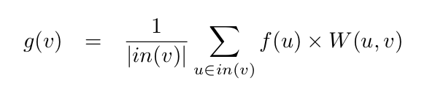
Goodness
W(u,v)
Fairness
f(u)
Goodness
g(v)
Weighted incoming rating

Slide 8
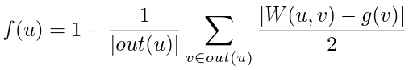
Fairness
W(u,v)
Fairness
f(u)
Goodness
g(v)
Average deviation of user u’s ratings
Deviation of rating from goodness

Slide 9
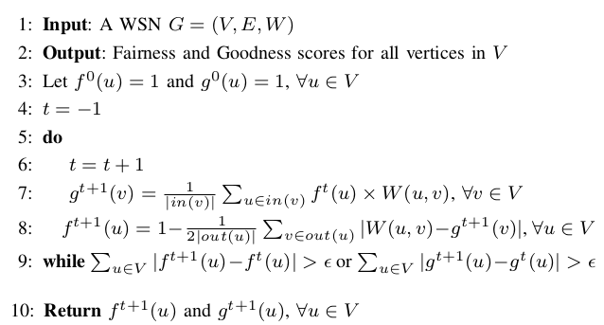
Fairness and Goodness Algorithm
Initialization
Update
Goodness
Update
Fairness

Slide 10
Initialization: All Fair and All Good
f(u) = 1
f(u) = 1
g(v) = 1
f(u) = 1
g(v) = 1
f(u) = 1
g(v) = 1
f(u) = 1
f(u) = 1

Slide 11
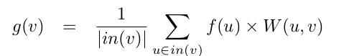
Updating Goodness - Iteration 1
f(u) = 1
f(u) = 1
g(v) = 0.67
f(u) = 1
g(v) = 0.67
f(u) = 1
g(v) = -0.67
f(u) = 1
f(u) = 1

Slide 12
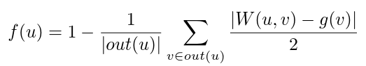
Updating Fairness - Iteration 1
f(u) = 0.58
f(u) = 0.92
g(v) = 0.67
f(u) = 0.92
g(v) = 0.67
f(u) = 0.92
g(v) = -0.67
f(u) = 0.92
f(u) = 0.92

Slide 13
… repeat until convergence
f(u) = 0.17
f(u) = 0.83
g(v) = 0.67
f(u) = 0.83
g(v) = 0.67
f(u) = 0.83
g(v) = -0.67
f(u) = 0.83
f(u) = 0.83
Predicted Edge Weight (u,v) = f(u) x g(v)

Slide 14
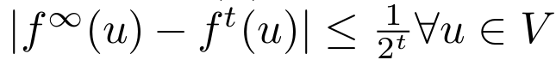
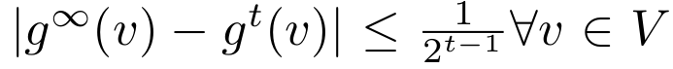
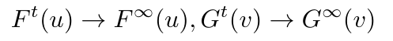
Theoretical Guarantees
Convergence Theorem: The error between iterations is bounded, and as t increases, the rating scores converge. The error bound is given by:
As t increases,
Uniqueness Theorem: Iterations converge to a unique solution, given the starting criteria.
Time Complexity: O(|E|)

Slide 15


Experiments: Data and settings
Two Bitcoin trust networks:
trust/distrust. 6k nodes, 36k edges
Wikipedia editor: agree/disagree
342k nodes, 5.6M edges
User-user network: like/dislike
365k nodes, 2.6M edges
Wikipedia adminship: support/oppose
10k nodes, 100k edges
User-user network: trust/distrust
196k nodes, 4.8M edges
Notes:
Bitcoin Trust datasets: Trust/Distrust
Wikipedia Request for Adminship: Trust/Distrust, Like/Dislike
Wikipedia Editor Network: Agree/Disagree
Epinions: Trust/Distrust, Agree/Disagree
Twitter: Like/Dislike, Agree/Disagree

Slide 16
Comparisons
Reciprocal edge weight
Triadic balance theory
Triadic status theory
Local status theory
Weighted PageRank
Signed Eigenvector Centrality
Signed-HITS
Bias and Deserve
TidalTrust Algorithm
EigenTrust Algorithm
MDS Algorithm
Methods are adapted to work on weighted and signed networks, whenever applicable.
Performance metrics:
Root Mean Square Error (RMSE)
and
Pearson Correlation Coefficient (PCC)

Slide 17
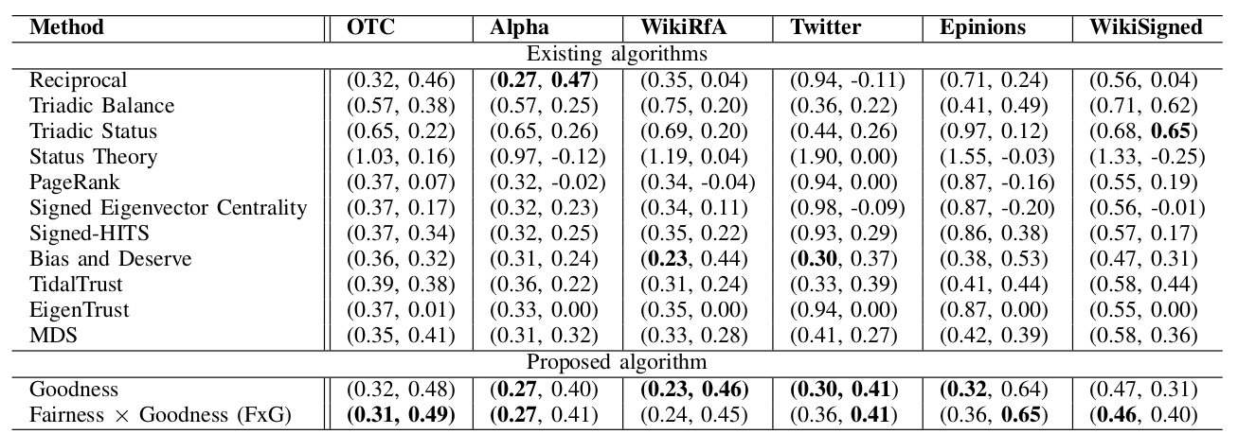
Prediction: Leave-one-edge-out
Two predictions:
Predicted edge weight (u,v) = g(v)
Predicted edge weight (u,v) = f(u) x g(v)
Fairness and Goodness predictions are overall more accurate than existing algorithms
Notes:
Deleted weight of edge

Slide 18
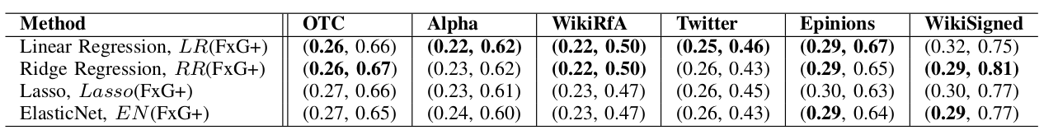
Prediction: Supervised Regression Model
Prediction by all methods are put into a regression model and trained on the training edge set. The learned model is used to predict edge weight of test edge.
Fairness and Goodness features are the most important features in the Linear Regression model in most networks.
Notes:
ADD feature importance

Slide 19
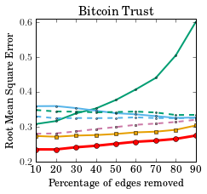
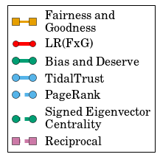
Prediction: N% Edge Removal
Lower error is better
Fairness and Goodness performs the best

Slide 20
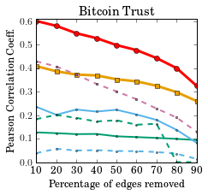
Prediction: N% Edge Removal
Higher correlation is better
Fairness and Goodness performs the best

Slide 21
Conclusions
Two novel metrics: Fairness and Goodness
General metrics for any weighted graph
In this work, used to predict edge weight in weighted signed networks
Scalable, with time complexity O(|E|)
Guaranteed solution
Performs the best in predicting edge weights, both under leave-one-edge-out and N% edge removal cross-validation

Slide 22
Datasets and code at: http://cs.umd.edu/~srijan/wsn
Reach me at: srijan@cs.umd.edu
Website: http://cs.umd.edu/~srijan
Thank you!

Slide 23
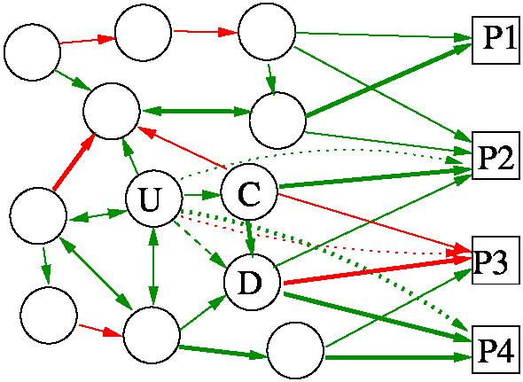
Applications
Identify potential customers
Add new aspect to standard
graph mining tasks:
Node ranking
Anomaly detection
Clustering
Community detection
Sentiment prediction
Information diffusion

